Slide 1
Harstad Builders Mobile App
Caleb Nwokocha

Slide 2
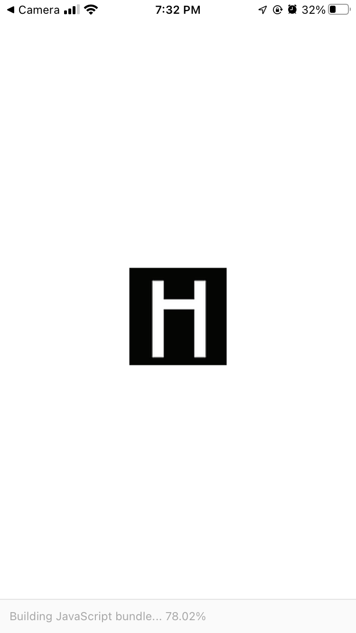
Splash
This is the first page that appear when client open the app
Ignore the item in the red box. That’s due to software emulation.

Slide 3
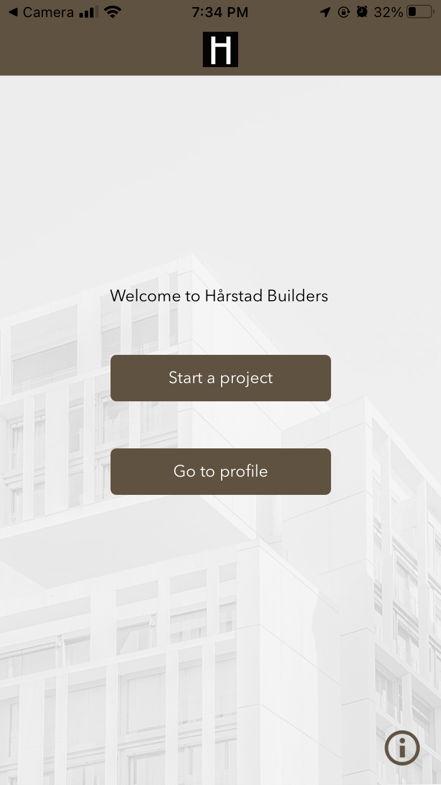
Home
Second page after the splash page
This page has three buttons
A = Area page
P = Profile page
Ab = About page
A
P
Ab

Slide 4
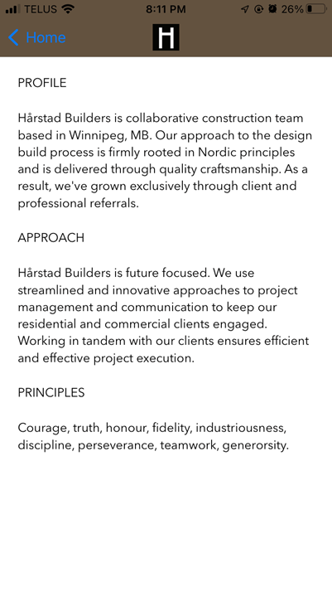
About
This is About page, Ab
Source: https://www.harstadbuilders.com/

Slide 5
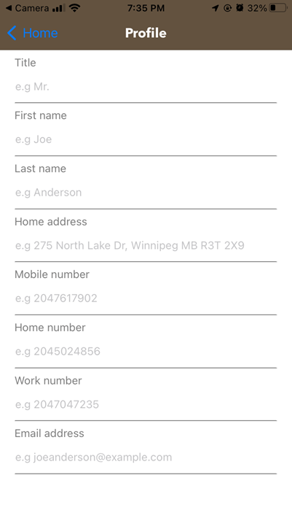
Profile
This is Profile page, P
Where clients setup their contact information

Slide 6
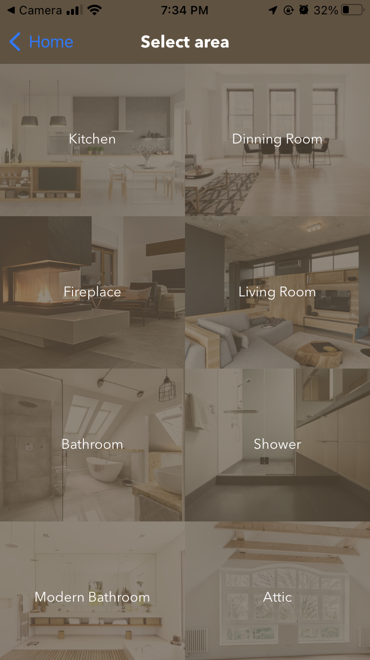
Area
Area page, A
Showing eight buttons in grid form
S = Services page
When tap, jump to S
S
S

Slide 7
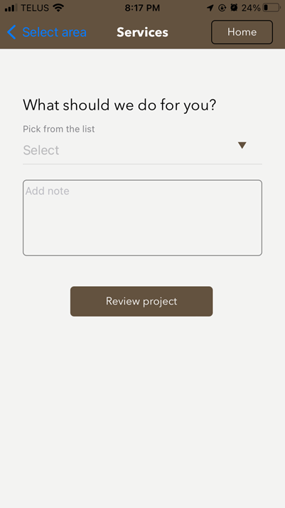
Services
This is Services page
Tap the any of the objects to open a drop-down menu
Objects

Slide 8
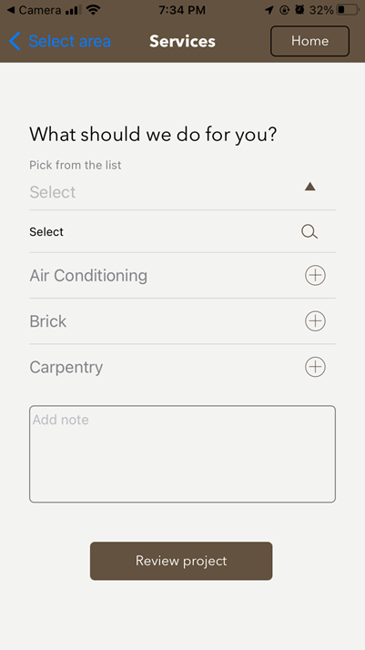
Services
Service page
There is scrollable drop-down menu that show selectable items
Selectable items

Slide 9
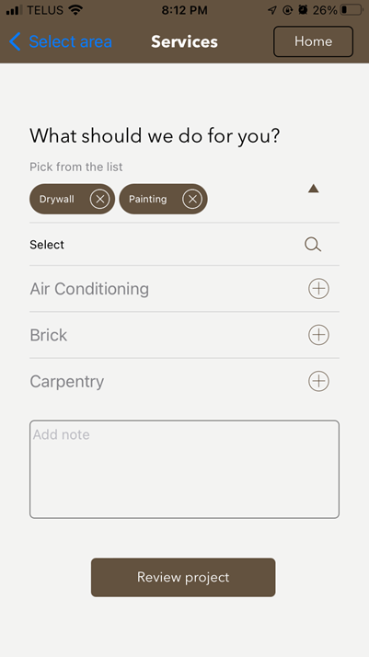
Services
Service page
Clients can add special note as project details
Selections

Slide 10
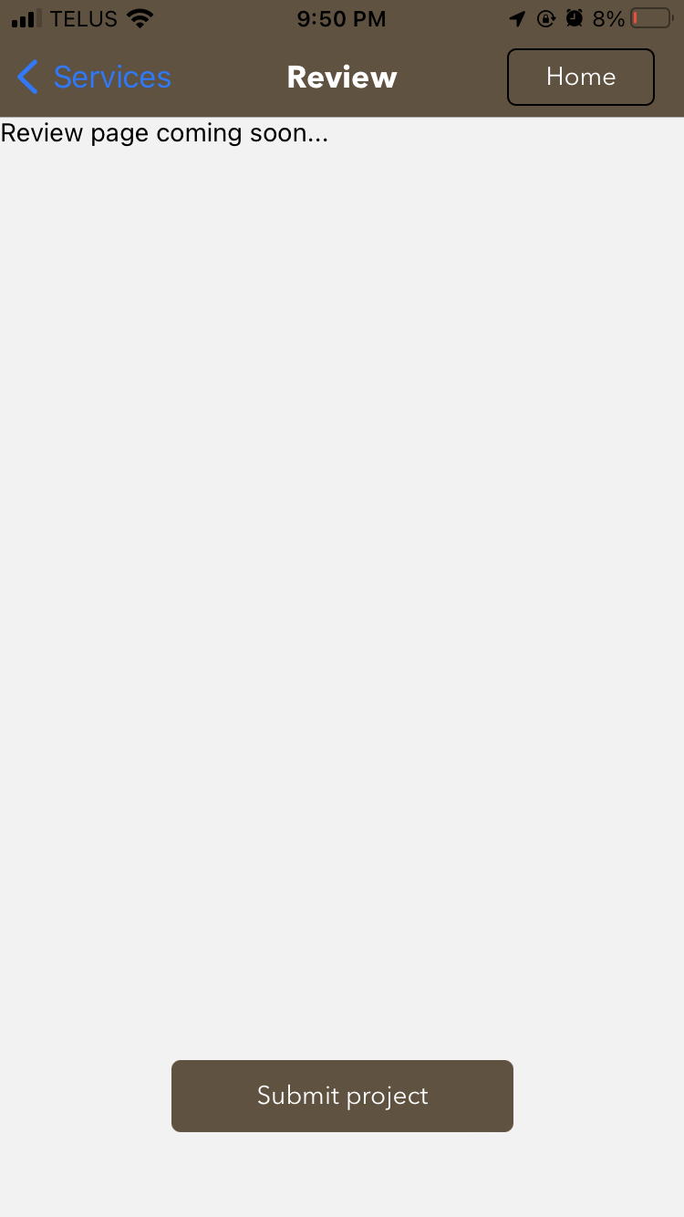
Review & Submit
TODO:
Implement database
Retrieve and display project details here for review and submission

